Slide 1
Escenic Content Studio
Notes:
The below and following notes on the template slides are to guide you only. In your final presentation, you may delete these notes and add relevant notes if any.
Title slide:
Title – should not exceed beyond 3 lines, font size 30-34, Arial Headings
(Font size for the title of the PPT can vary between 30-34, Arial Headings, Bold depending on the amount of text, however should not be smaller than 30 font size)
Name should not exceed beyond 1 line, Designation; font size to remain at 18, Arial Headings
Please keep the title slide simple, just the logo, title and name and designation to appear. No other graphic elements or any design, photograph, image can be added to this slide, alignment to remain the same

Slide 2
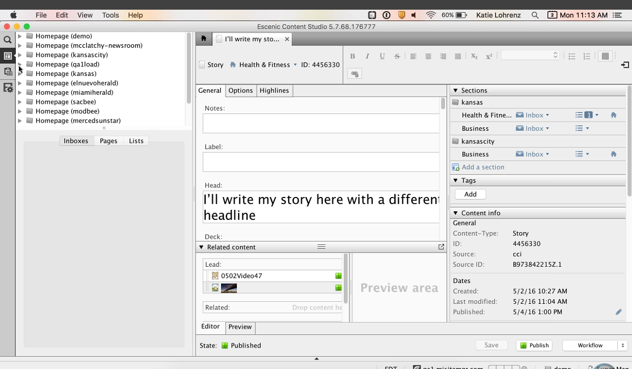
Escenic CS Tool Bar
Search button - Search/filter content based on date/status
Publication button – Lists various publications
Clipboard – Has the content for the user who has logged in.
Notes:
Content Slide: This is usually the most frequently used slide in every presentation.
Use this slide for Text heavy slides. Text can only be used in bullet points
Title Heading – font size 30, Arial Heading
Slide Content – Should not reduce beyond Arial body font 16
If you need to use sub bullets please use the indent buttons located next to the bullets buttons in the tool bar and this will automatically provide you with the second, third, fourth & fifth level bullet styles and font sizes
Please note you can also press the tab key to create the different levels of bulleted content

Slide 3
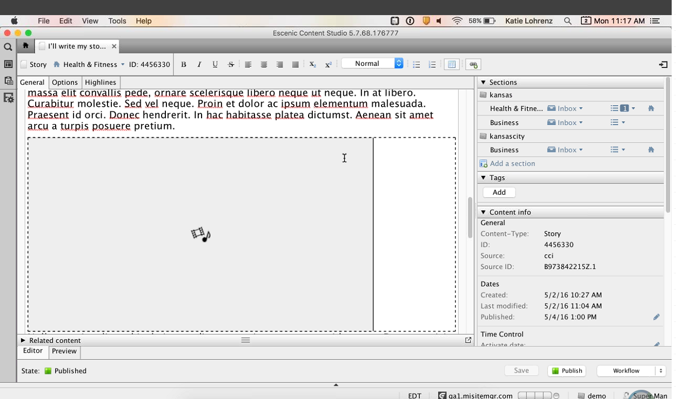
CCI Story as CS Article
Story created in NG is available as article in CS.
.
Notes:
Content Slide: This is usually the most frequently used slide in every presentation.
Use this slide for Text heavy slides. Text can only be used in bullet points
Title Heading – font size 30, Arial Heading
Slide Content – Should not reduce beyond Arial body font 16
If you need to use sub bullets please use the indent buttons located next to the bullets buttons in the tool bar and this will automatically provide you with the second, third, fourth & fifth level bullet styles and font sizes
Please note you can also press the tab key to create the different levels of bulleted content

Slide 4
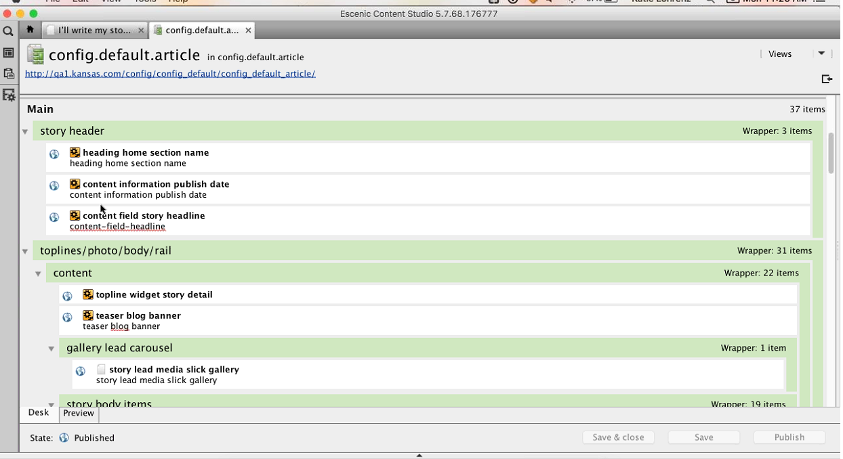
Creation of Page Layout
Template/Page Layout is available under config.default
Template files start with config.default as naming convention
Each and every page is a collection of various sections.
Each and every template has its own regions where the Widgets can be placed.
Content created through NG is available in the main area of the template.
Each and every content that get placed in the template are widgets.
No separate IDE for template creation/modification but to use CS itself
Config.default.article holds the layout for the particular article
Each and every section inside an article is assigned with a particular template.
.
Notes:
Content Slide: This is usually the most frequently used slide in every presentation.
Use this slide for Text heavy slides. Text can only be used in bullet points
Title Heading – font size 30, Arial Heading
Slide Content – Should not reduce beyond Arial body font 16
If you need to use sub bullets please use the indent buttons located next to the bullets buttons in the tool bar and this will automatically provide you with the second, third, fourth & fifth level bullet styles and font sizes
Please note you can also press the tab key to create the different levels of bulleted content

Slide 5
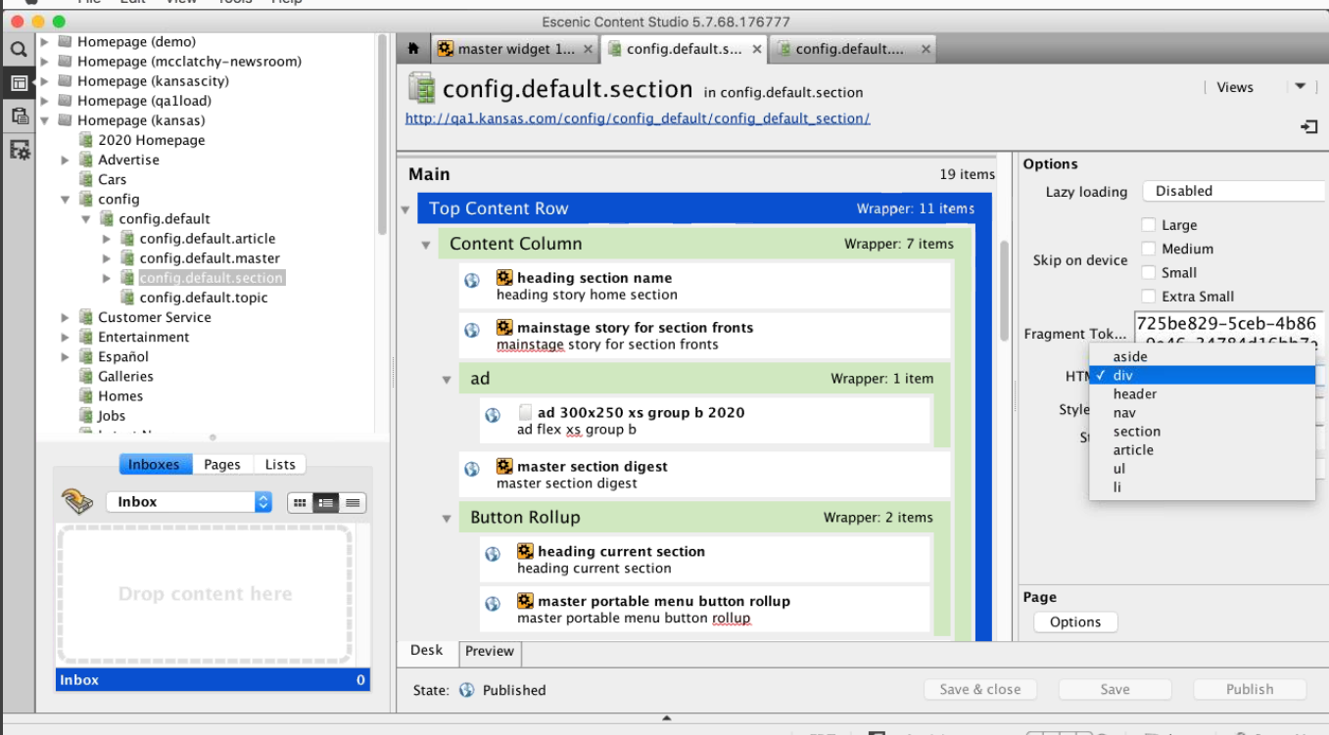
Creation of Section Layout
To have more content inside a section we can create rows of column based layout.
By Default WF looks for the specific template of a particular section.
If it is not found then the default section template is considered by Escenic WF.
Section specific template can be created using config.default.<section name> under config.default
Menus in the page come from a separate section config.default.master.masthead
The individual menu items are available in a XML file
For gallery slick a jquery plugin is used as it is responsive
.
Notes:
Content Slide: This is usually the most frequently used slide in every presentation.
Use this slide for Text heavy slides. Text can only be used in bullet points
Title Heading – font size 30, Arial Heading
Slide Content – Should not reduce beyond Arial body font 16
If you need to use sub bullets please use the indent buttons located next to the bullets buttons in the tool bar and this will automatically provide you with the second, third, fourth & fifth level bullet styles and font sizes
Please note you can also press the tab key to create the different levels of bulleted content

Slide 6
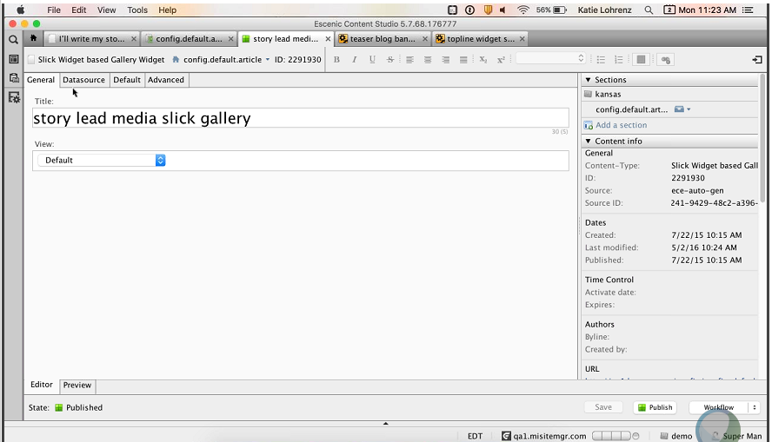
Creation of Section Layout
Notes:
Content Slide: This is usually the most frequently used slide in every presentation.
Use this slide for Text heavy slides. Text can only be used in bullet points
Title Heading – font size 30, Arial Heading
Slide Content – Should not reduce beyond Arial body font 16
If you need to use sub bullets please use the indent buttons located next to the bullets buttons in the tool bar and this will automatically provide you with the second, third, fourth & fifth level bullet styles and font sizes
Please note you can also press the tab key to create the different levels of bulleted content

Slide 7
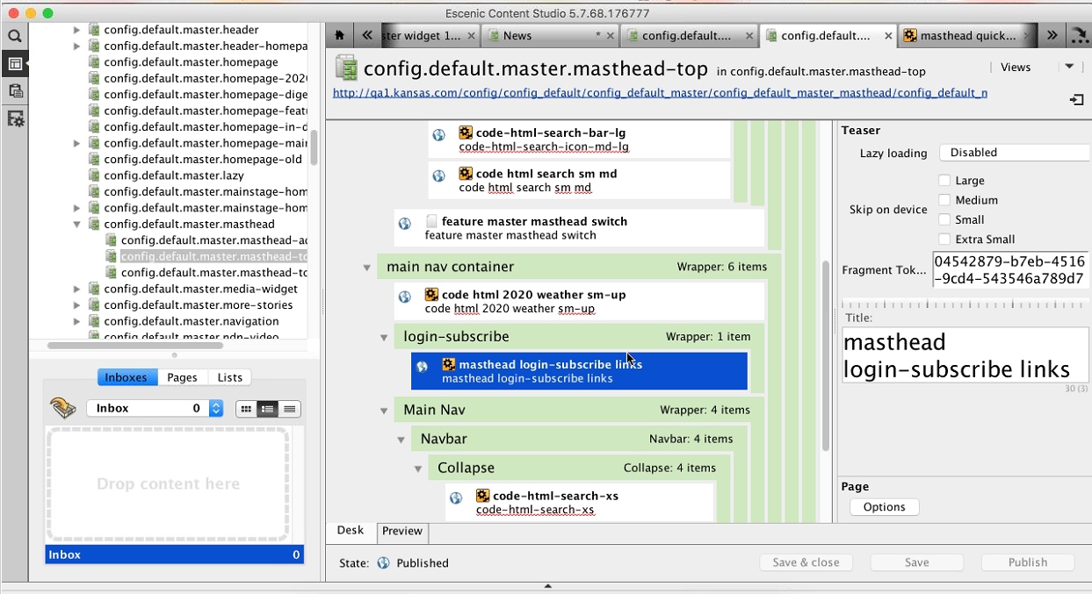
Creation of Section Layout
Notes:
Content Slide: This is usually the most frequently used slide in every presentation.
Use this slide for Text heavy slides. Text can only be used in bullet points
Title Heading – font size 30, Arial Heading
Slide Content – Should not reduce beyond Arial body font 16
If you need to use sub bullets please use the indent buttons located next to the bullets buttons in the tool bar and this will automatically provide you with the second, third, fourth & fifth level bullet styles and font sizes
Please note you can also press the tab key to create the different levels of bulleted content

Slide 8
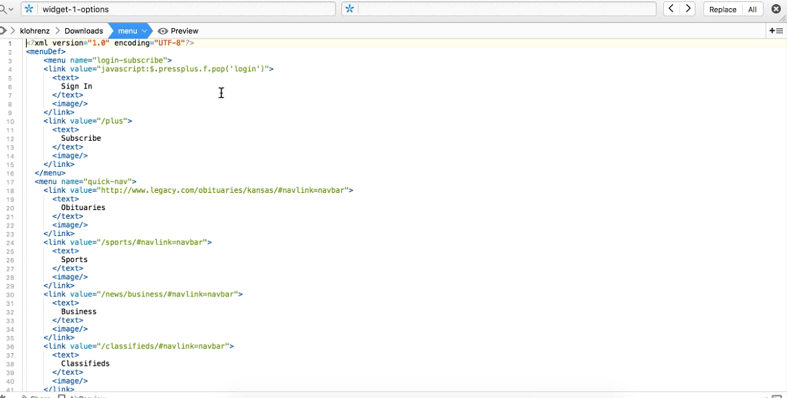
Creation of Section Layout
Notes:
Content Slide: This is usually the most frequently used slide in every presentation.
Use this slide for Text heavy slides. Text can only be used in bullet points
Title Heading – font size 30, Arial Heading
Slide Content – Should not reduce beyond Arial body font 16
If you need to use sub bullets please use the indent buttons located next to the bullets buttons in the tool bar and this will automatically provide you with the second, third, fourth & fifth level bullet styles and font sizes
Please note you can also press the tab key to create the different levels of bulleted content

Slide 9
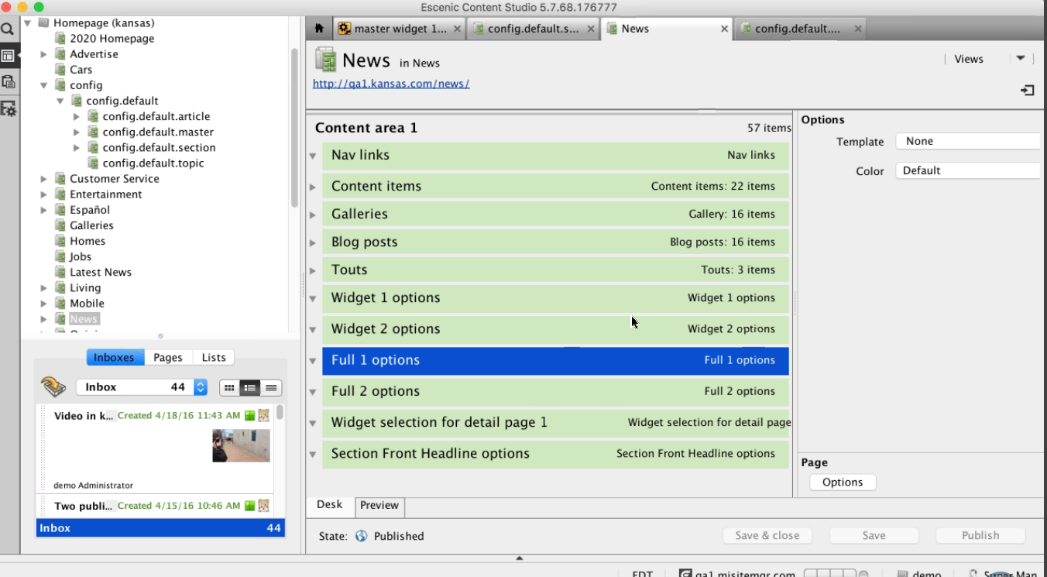
Assignment of Widgets to Sections
Already existing widgets are available to all publications.
Each and every publication would assign the widgets to the particular section.
No drag and drop for ordering the widgets.
Based on the creation of widgets, the ordering happens on the WF
Widget once created are assigned with the particular section template.
We have different config section for every publication or the market
Each section have separate templates/config files for them
Notes:
Content Slide: This is usually the most frequently used slide in every presentation.
Use this slide for Text heavy slides. Text can only be used in bullet points
Title Heading – font size 30, Arial Heading
Slide Content – Should not reduce beyond Arial body font 16
If you need to use sub bullets please use the indent buttons located next to the bullets buttons in the tool bar and this will automatically provide you with the second, third, fourth & fifth level bullet styles and font sizes
Please note you can also press the tab key to create the different levels of bulleted content

Slide 10
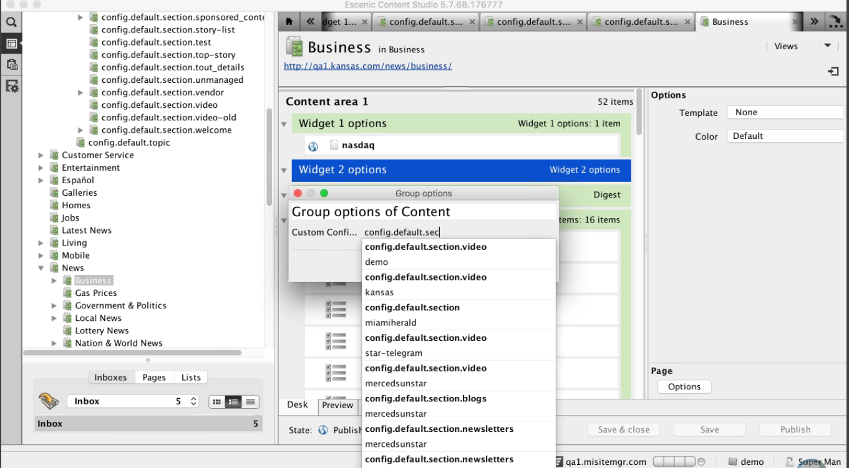
Assignment of Content to Widgets
The widgets are assigned with content.
The content inside the widget is configurable
Layout group file holds the section and the widgets under each section
Each widget is available as link and can be tested in the browser.
Modifying a layout-group file is manually done
Notes:
Content Slide: This is usually the most frequently used slide in every presentation.
Use this slide for Text heavy slides. Text can only be used in bullet points
Title Heading – font size 30, Arial Heading
Slide Content – Should not reduce beyond Arial body font 16
If you need to use sub bullets please use the indent buttons located next to the bullets buttons in the tool bar and this will automatically provide you with the second, third, fourth & fifth level bullet styles and font sizes
Please note you can also press the tab key to create the different levels of bulleted content

Slide 11
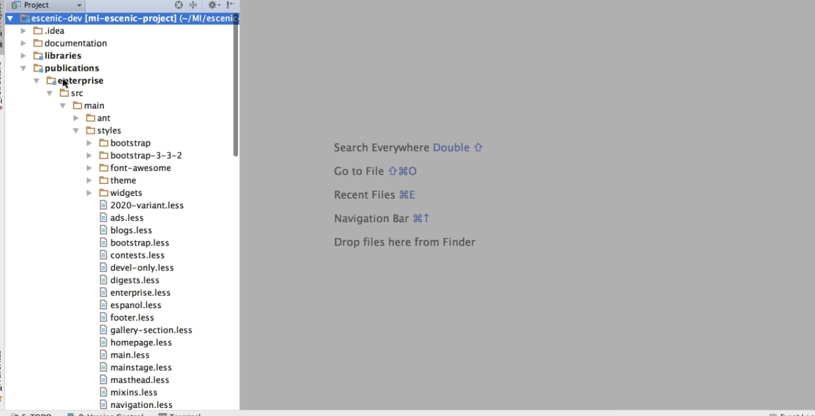
Custom Styling/JS/JSP
The basic layout happens through WF.
In the backend WF holds JSP /JS and CSS files.
Each and every publication has a custom stylesheet (.less file)
Notes:
Content Slide: This is usually the most frequently used slide in every presentation.
Use this slide for Text heavy slides. Text can only be used in bullet points
Title Heading – font size 30, Arial Heading
Slide Content – Should not reduce beyond Arial body font 16
If you need to use sub bullets please use the indent buttons located next to the bullets buttons in the tool bar and this will automatically provide you with the second, third, fourth & fifth level bullet styles and font sizes
Please note you can also press the tab key to create the different levels of bulleted content

Slide 12
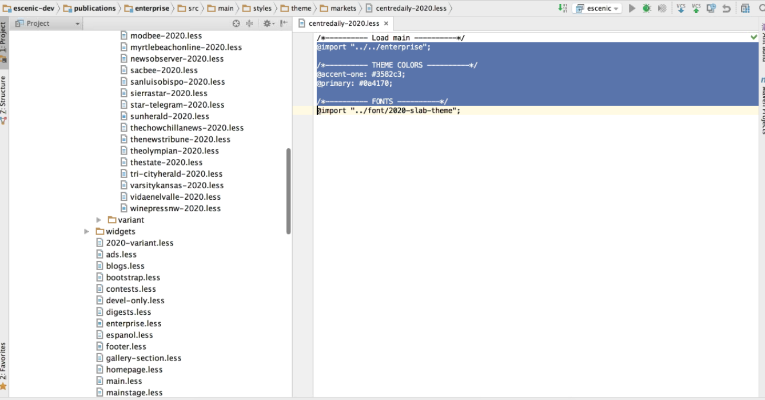
Custom Styling/JS/JSP
Notes:
Content Slide: This is usually the most frequently used slide in every presentation.
Use this slide for Text heavy slides. Text can only be used in bullet points
Title Heading – font size 30, Arial Heading
Slide Content – Should not reduce beyond Arial body font 16
If you need to use sub bullets please use the indent buttons located next to the bullets buttons in the tool bar and this will automatically provide you with the second, third, fourth & fifth level bullet styles and font sizes
Please note you can also press the tab key to create the different levels of bulleted content

Slide 13
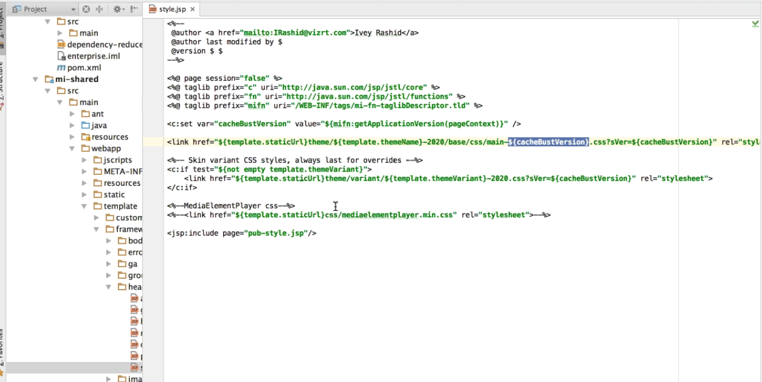
Custom Styling/JS/JSP
Notes:
Content Slide: This is usually the most frequently used slide in every presentation.
Use this slide for Text heavy slides. Text can only be used in bullet points
Title Heading – font size 30, Arial Heading
Slide Content – Should not reduce beyond Arial body font 16
If you need to use sub bullets please use the indent buttons located next to the bullets buttons in the tool bar and this will automatically provide you with the second, third, fourth & fifth level bullet styles and font sizes
Please note you can also press the tab key to create the different levels of bulleted content

